Slide 1
Movie Recommendation System
Thomas Sosa
Tomas Arenas
Zachary Wittmann

Slide 2
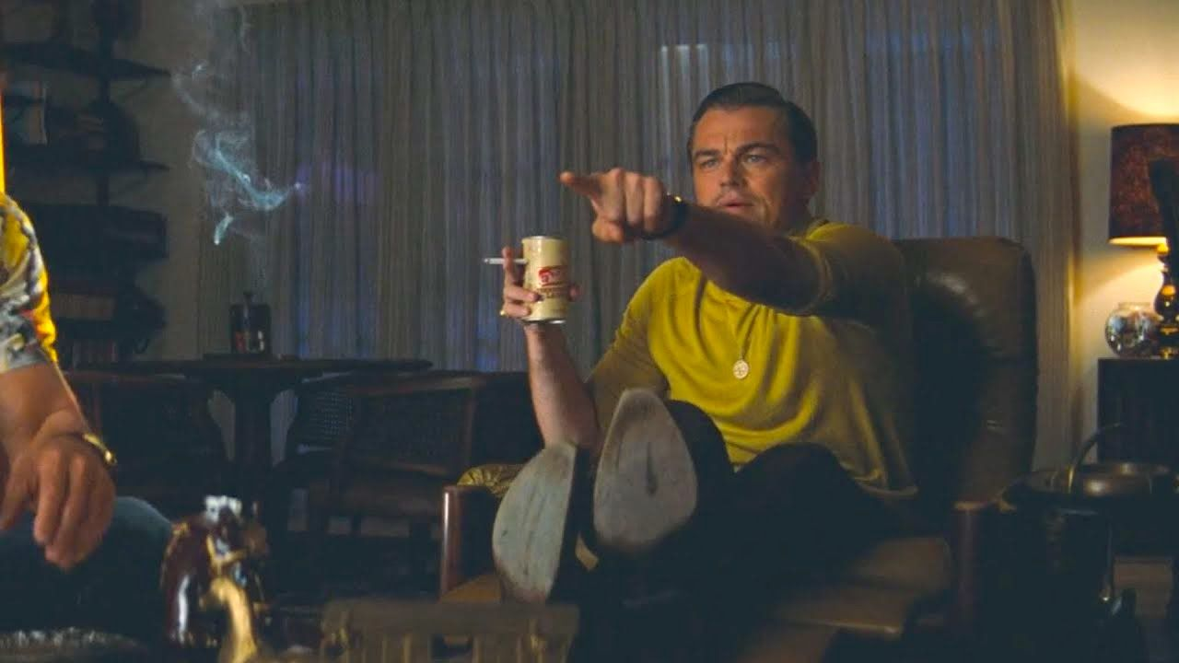

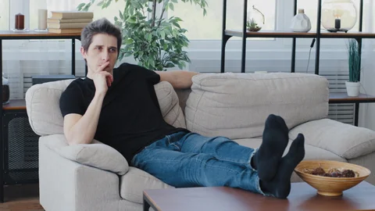

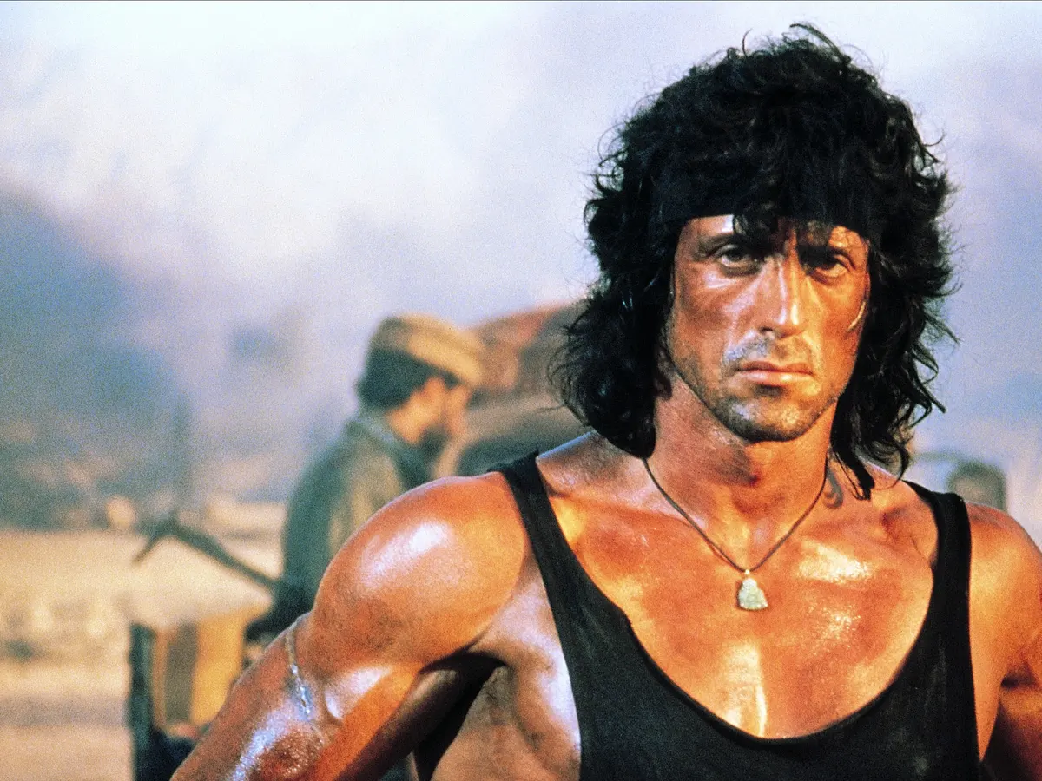
Notes:
Set the scene for the audience

Slide 3
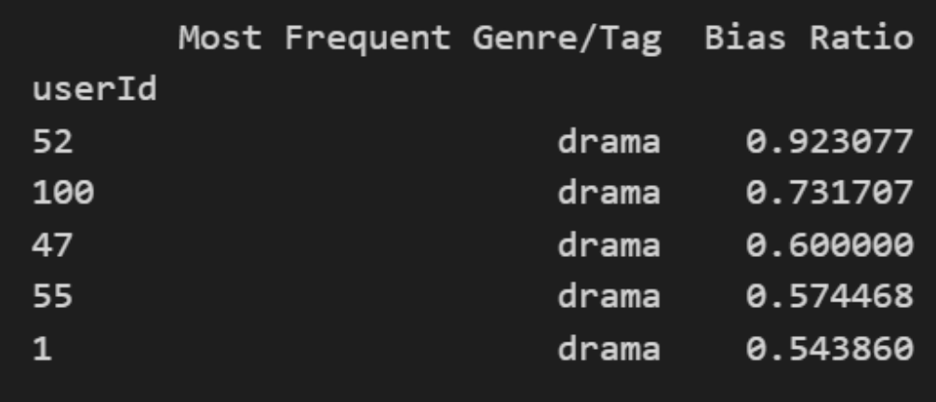
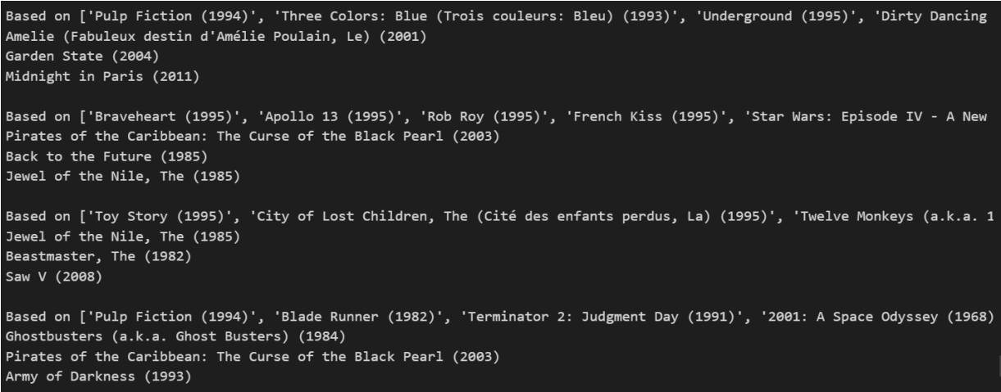
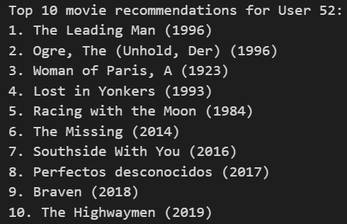
Examples of model doing predictions
Top 5 users (of first 100) with bias towards a genre
Example 1: Top 3 for first 4 users
Example 2: Top 10 word embeddings for user 52
Notes:
Briefly explain some of the examples that are shown on the slide, mention that no real changes were made to the project here

Slide 4
The Process
First
Second
Third
Fourth
Fifth
Last
The idea
The Datasets
Initial Cleaning
Pre-Processing
Create Tag Values
Build the Model
Utilize knn with the data we will get to allow for plotting movies with embeddings.
Downloading and exploring MovieLens dataset
Removal of unimportant information from the files.
Create datasets for the user and their liked genre/tags, and the movies and their genre/tags.
Using knn requires numeric values for use, so embedding time.
Embeddings? Plugged. Knn model? Created. Similarity? Cosine. Hotel? Trivago.
Notes:
Discuss the process (Next slide has some of the csv files contents for added visual)

Slide 5

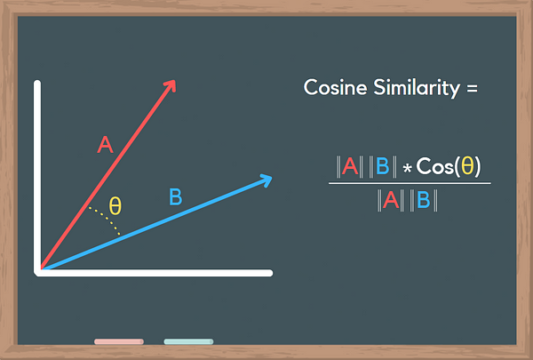
Our Model:
K NEAREST
K-Nearest Neighbor(KNN)
Pros
Simplicity
Dynamic Learning
Cons
Scalability
Cosine Similarity
Effectiveness with sparse data
Angle between vectors instead of magnitude
GloVe (Global Vectors for Word Representation)
Combines word co-occurrence information to obtain semantic relationships
Why not word2vec?
Relies on local information from local windows
Notes:
Talk about why we picked knn and why we haven’t compared it to other models
knn is a non-parametric and instance-based learning algorithm, so slightly less effective than others but simpler to implement

Slide 6
MovieLens 25M Dataset
25 million ratings
1 million tag applications applied to 62,000 movies by 162,000 users
Includes tag genome data with 15 million relevance scores across 1,129 tags.
Released 12/2019
Includes 6 csvs
movies.csv
ratings.csv
tags.csv
links.csv
genome-tags.csv
genome-scores.csv

Slide 7
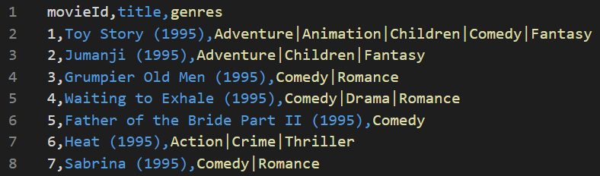
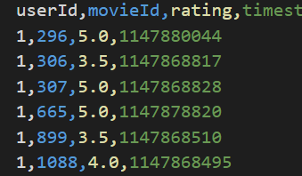
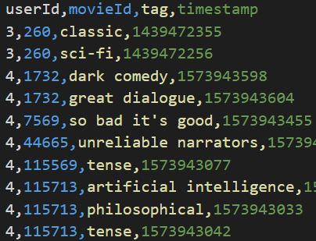
Initial Cleaning
Ratings (Users)
Movies
Tags
userId
movieId
rating(>=4.0)
movieId
title
genre
userId
movieId
tag
timestamp
timestamp
Notes:
Discuss the csv files we initially had and some examples of them/ how they were important
Then mention how we converted them into user_liked_genres&tags and movies_genres&tags

Slide 8
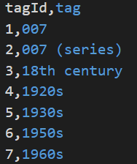
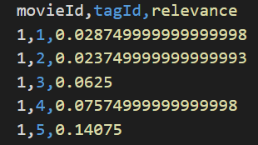
Genome data
genome-tags
genome-scores
tagId
tag
movieId
tagId
relevance
Notes:
Discuss the csv files we initially had and some examples of them/ how they were important
Then mention how we converted them into user_liked_genres&tags and movies_genres&tags

Slide 9
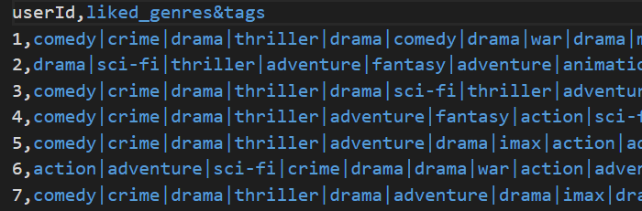
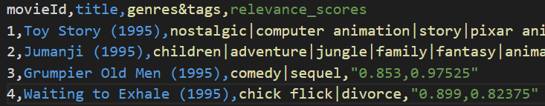
Two datasets
Movies-based dataset
Used to train model
Contains movies and every single tag every user that watched the movie tagged it
Also contains relevance scores for each tag(for each movie)
Users-based dataset
Used to query the model
Contains genres/tags of movies user “liked”

Slide 10
Word Embeddings
Movies-based dataset
Turn each genre/tag into a word embedding
Phrases need to be turned into word embeddings and averaged out
Multiply each genre/tag’s word embedding to the relevance_score
Average out those results into one word embedding
Users-based dataset
Turn each genre/tag into a word embedding
Phrases need to be turned into word embeddings and averaged out
Average out those results into one word embedding

Slide 11
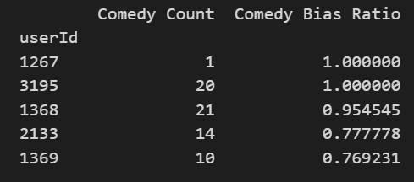
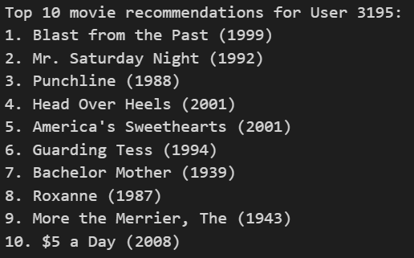
Evaluation 1 - Eye Test(with a bit of data)
Comedy/Romance
Comedy/Drama
Comedy/Romance
Comedy/Romance
Comedy/Romance
Comedy/Thriller
Comedy/Romance
Comedy/Romance
Comedy/Romance
Comedy/Drama

Slide 12
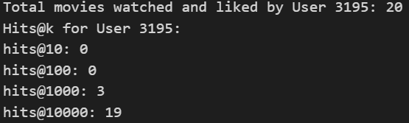
Evaluation 2 - hits@k

Slide 13
What we could have done differently
Use all ratings from users, normalize them from 1-5 to 0-1, then use them as weights for the user-based dataset.
Use relevance scores as weights for the use-based dataset, same as we did for the movies-based one
Notes:
“Use all ratings”, meaning instead of just >=4.0
Relevance scores - “we can still argue the way we did it made sense too” (explain why)

Slide 14
Improvements
Use imdb scores either as weights to the cosine similarity measurements.
Adjusted Similarity=Cosine Similarity×(α×Normalized imdb Score+(1−α))
α: This is a weighting factor that determines the balance between the original Cosine Similarity score and the normalized movie rating. It's a value between 0 and 1.
If α is close to 1, the rating has a greater influence on the adjusted similarity score.
If α is close to 0, the original Cosine Similarity (based on genres/tags) has a greater influence.
Add more features from imdb(conveniently given by link.csv)
Director
Lead Actor
Runtime

Slide 15
References
https://grouplens.org/datasets/movielens/
Jesse Vig, Shilad Sen, and John Riedl. 2012. The Tag Genome: Encoding Community Knowledge to Support Novel Interaction. ACM Trans. Interact. Intell. Syst. 2, 3: 13:1–13:44. <https://doi.org/10.1145/2362394.2362395>

